Slide 1
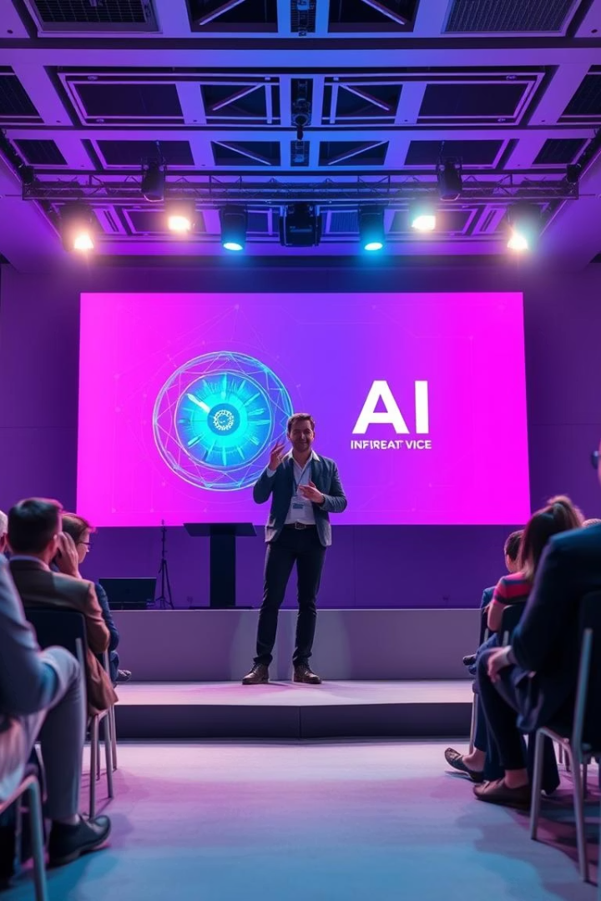
My Hand Sign Detection AI
Presented by: Akshat Saini and Raghav Garg
BTech CSE, Bennett University

Slide 2
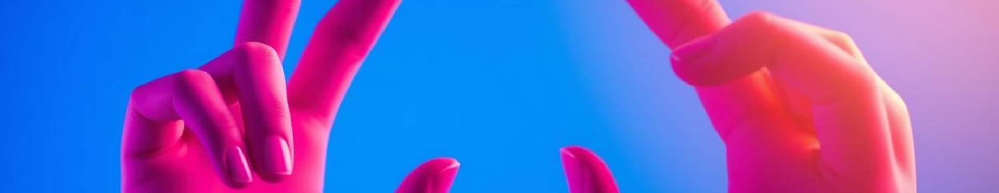
Why This Project?
This project addresses communication barriers. Speech/hearing-impaired individuals face daily challenges. Sign language is not universally understood.
The goal is to create an AI. The AI translates hand signs into audio. This will enable real-time communication.
Communication
Understanding
Real-time
Breaks down communication barriers.
Promotes wider sign language understanding.
Enables instant audio translation.

Slide 3
Tools and Technologies
The project leverages several key technologies.
These tools facilitate model building and deployment.
Model
Framework
MobileNetV2: Achieved 70%+ accuracy. Optimized for mobile deployment.
TensorFlow/Keras: For model building and training. Enabled rapid prototyping.
Python's libraries streamlined data processing. The dataset used combines custom and ASL data.

Slide 4
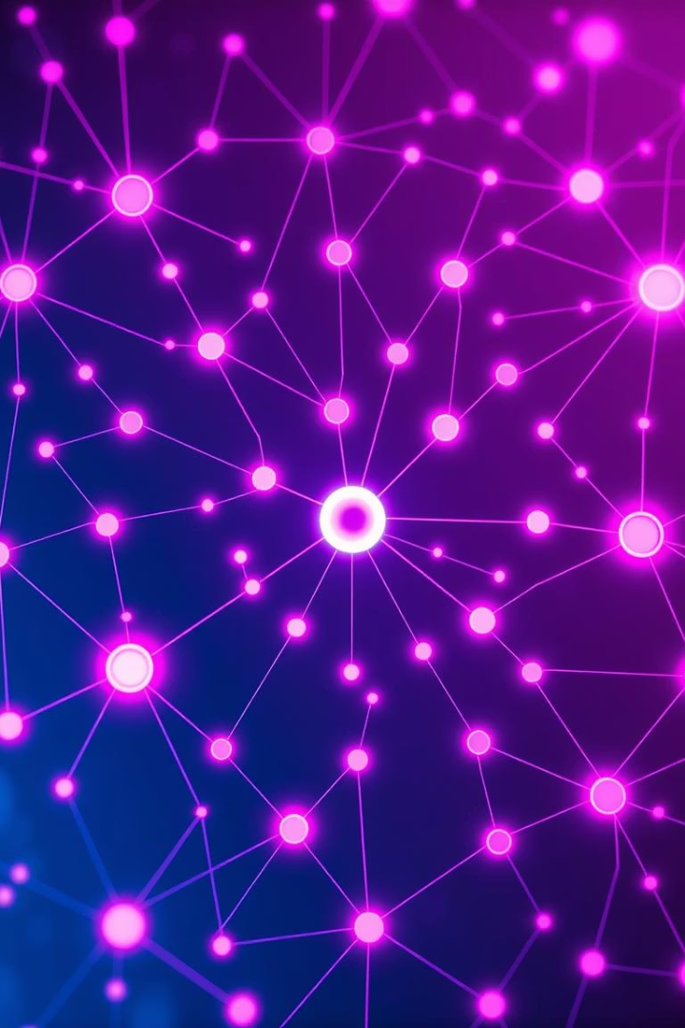
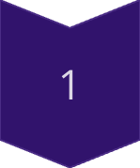
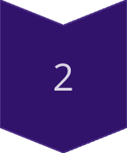
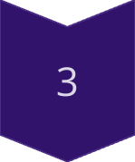
Implementation & Results
Image preprocessing increased model accuracy.
Training details show the model achieved 70% validation accuracy.
Preprocessing
Grayscaling, resizing, normalization
Training
Trained for 15 epochs
Demo
Real-time hand sign detection with OpenCV

Slide 5
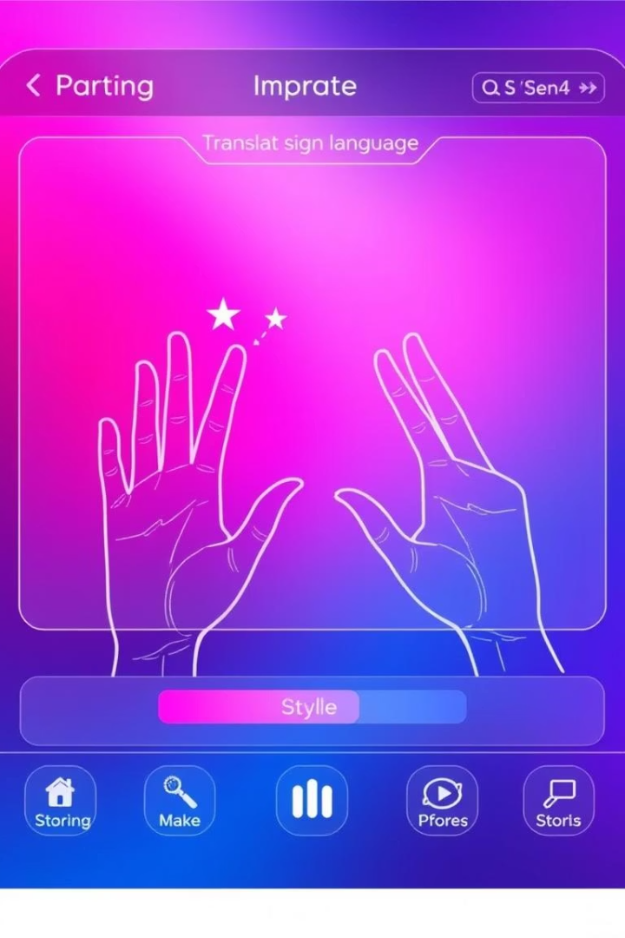
Conclusion & Future Work
The project successfully created a real-time hand sign detection AI.
Significant progress has been made towards bridging the communication gap.
Dataset
Accuracy
Expand to include more signs/gestures.
Improve model accuracy and robustness.
Integration
Integrate with a mobile app.

